Slide 1
User manual Dynamic Mathematics Principles
Team: Andres Cubas, Ingrid Troche
Mentor: Mario Eraso

Slide 2
Overview
You can use the Dynamic Mathematics Principles applications for educational purposes
This manual delivers an overview of the sample application. Beginning with the following information:
Create Account
Login
Logout
Select Activity
Select Fun-facts pages
Select History pages
Search
Take Quiz
View Hints
Rate Activity
Send feedback
View about us
Take Survey

Slide 3
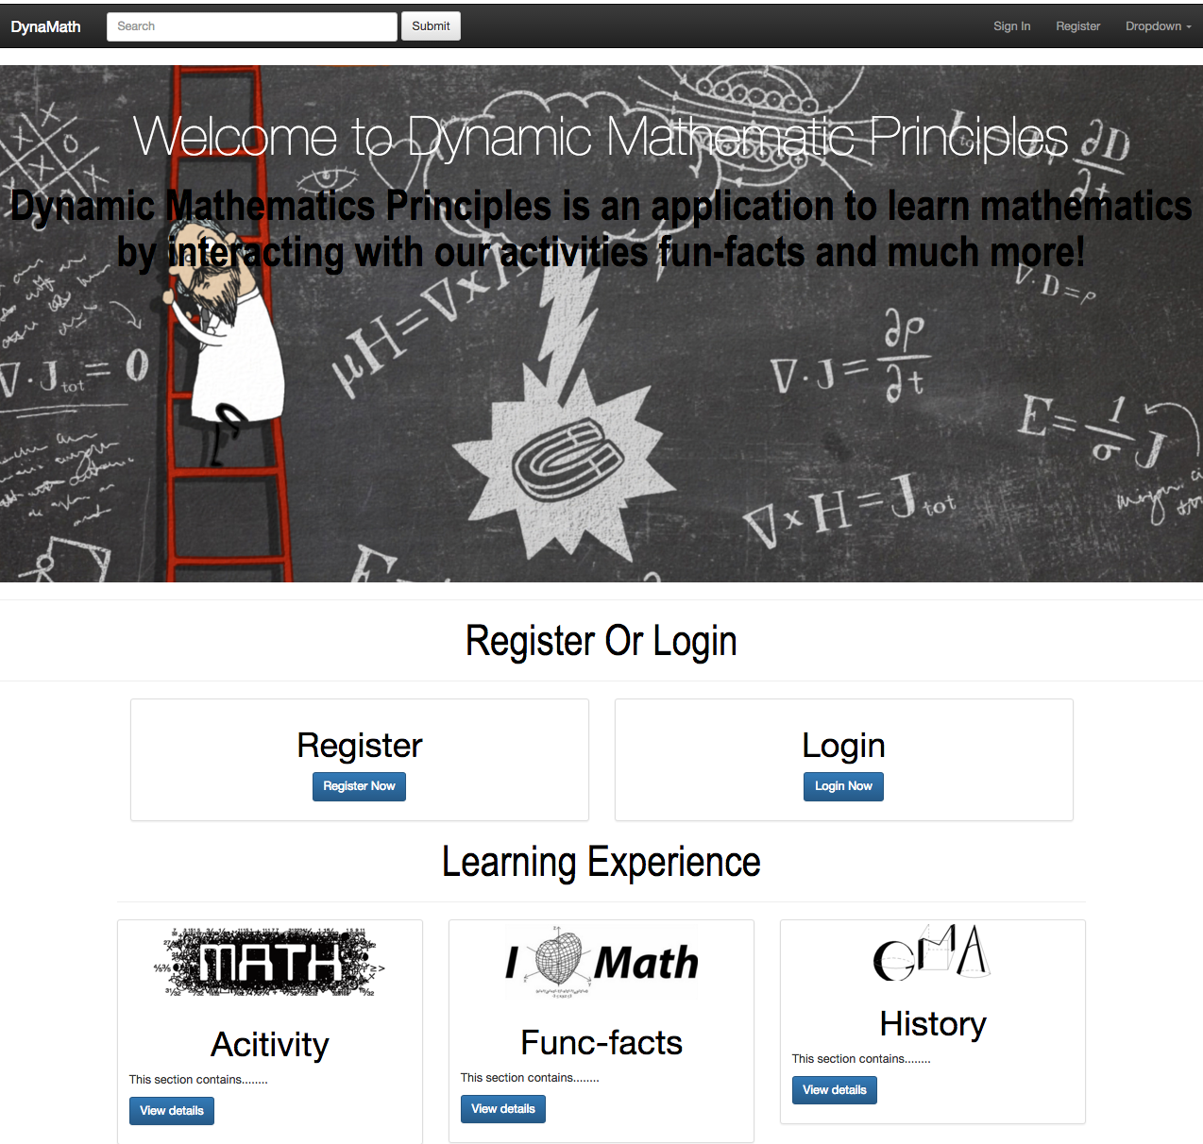
Step 1
User can click on register or login
User can click on our trial activities

Slide 4
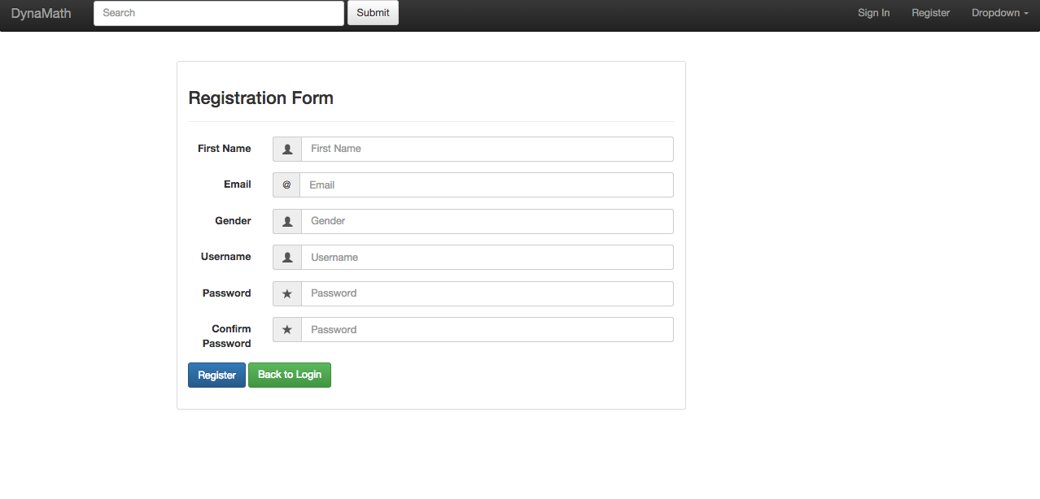
Step 2
The user is required to enter first name
The user is required to enter email
The user is required to enter username
The user is required to enter password and confirm password

Slide 5
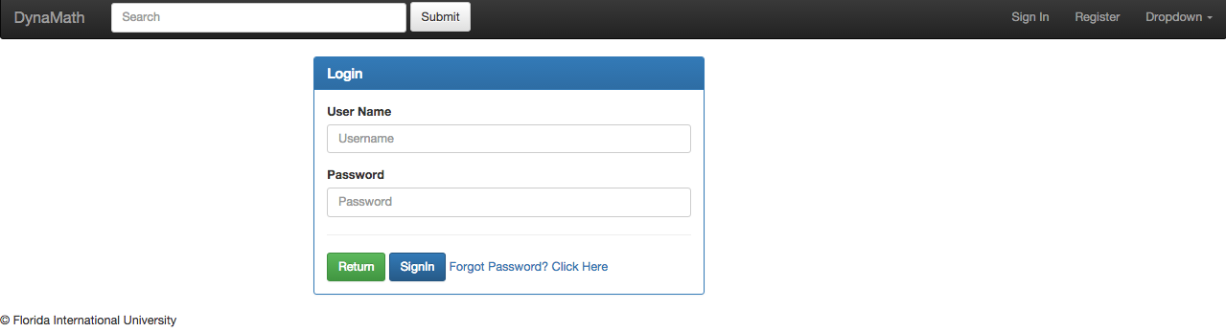
Step 3
The user is required to enter username and password and make a click in sign in button or return button to return to main page
First the user need to create account button look at step 1 to complete requirements

Slide 6
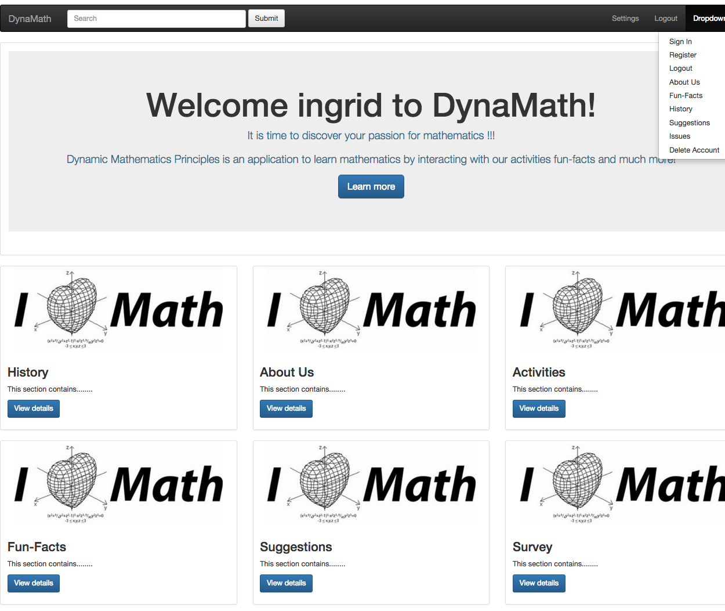
Step 4
The user can click on settings to modify account

Slide 7
Step 5
The user can search the website by typing on our search textbox and clicking submit

Slide 8
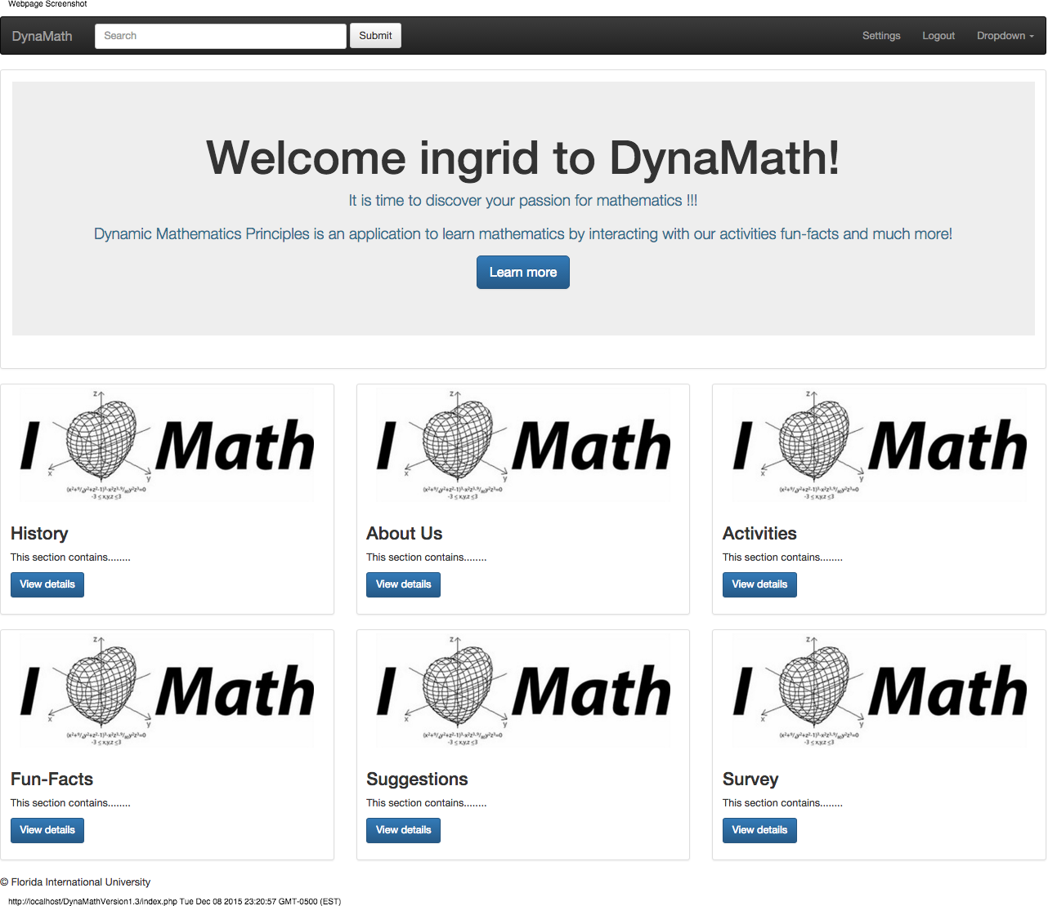
Step 6
The user can select History page
The user can select About us page
The user can select Activities page
The user can select About us page
The user can select Suggestions page
The user can select Surveys pages

Slide 9
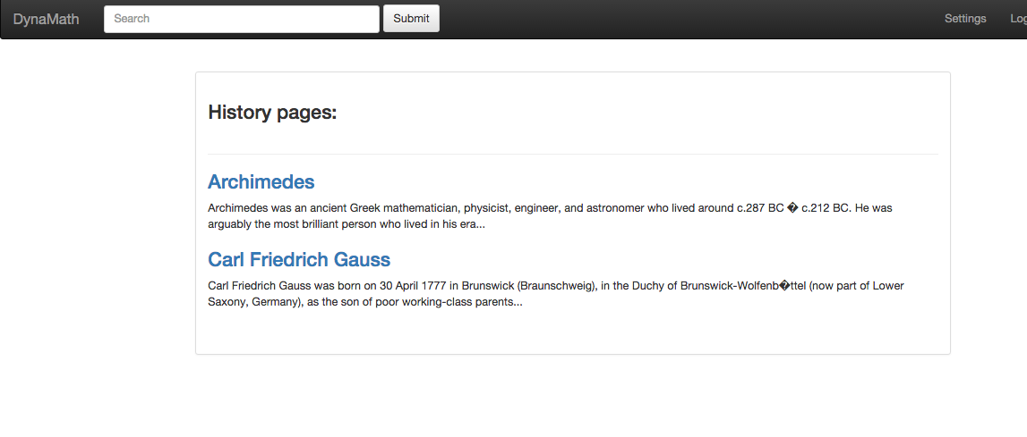
Step 7
The user can select which history he/she wishes to read from our history page

Slide 10
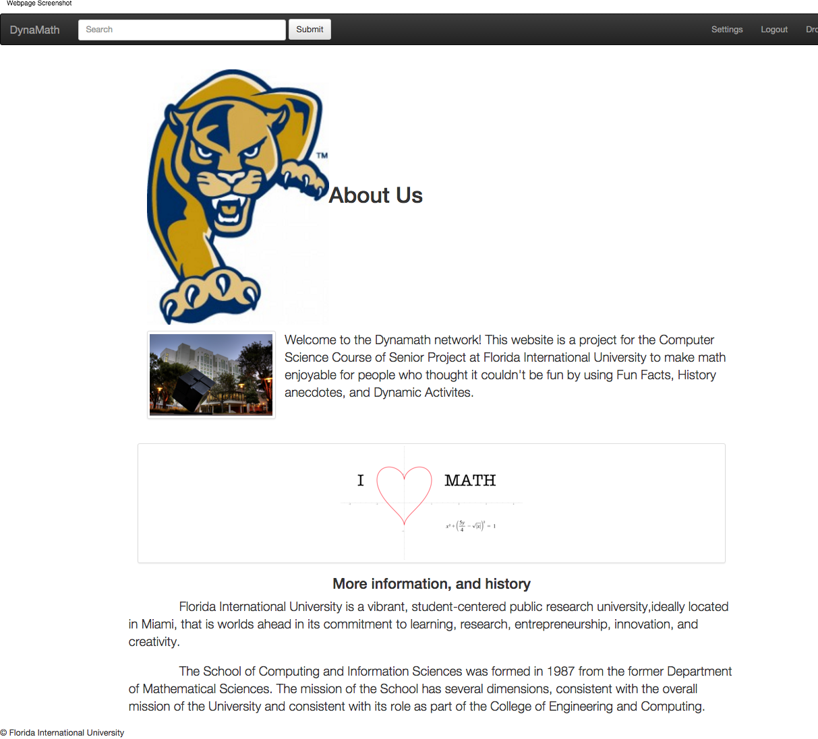
Step 8
User can read more about the project and FIU school of computing

Slide 11
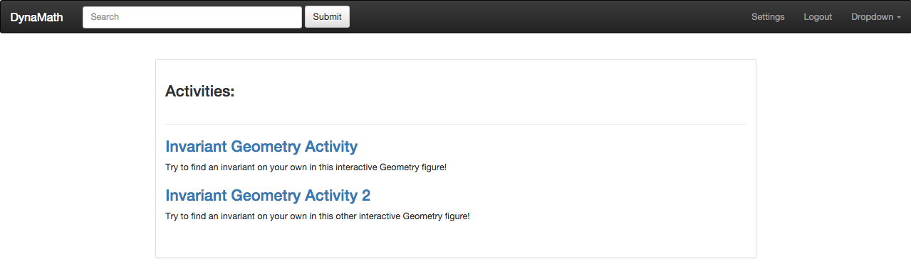
Step 9
User can select an activity from our Activity page

Slide 12
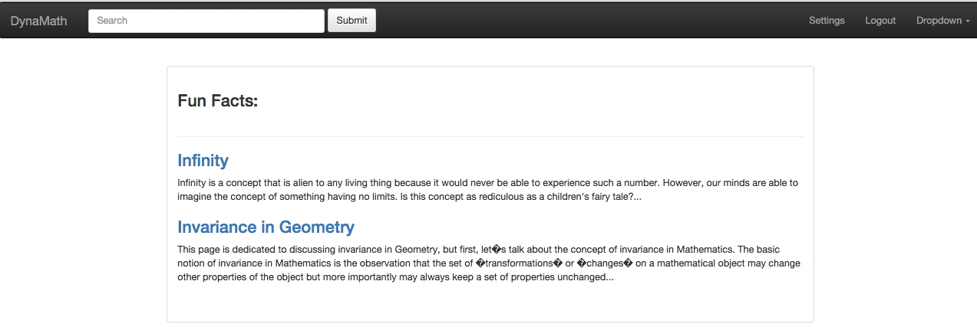
Step 10
User can select a fun-fact to review from our fun-facts page

Slide 13
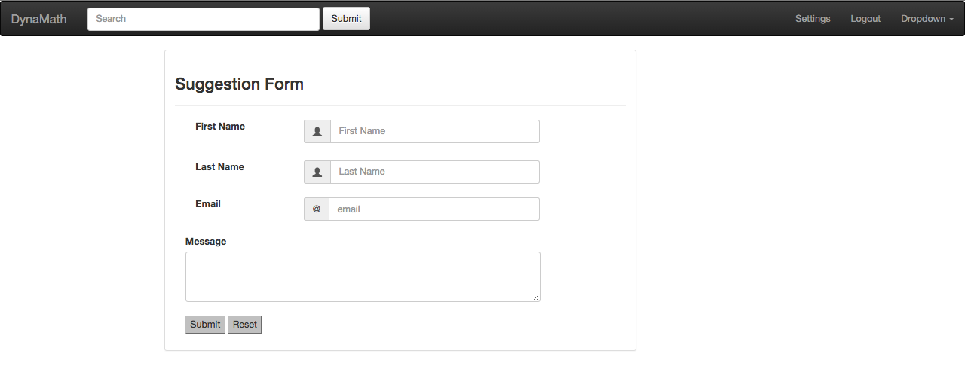
Step 11
The user can send feedback from our suggestion form
The user can click on the submit button to submit data or click on reset to reset information

Slide 14
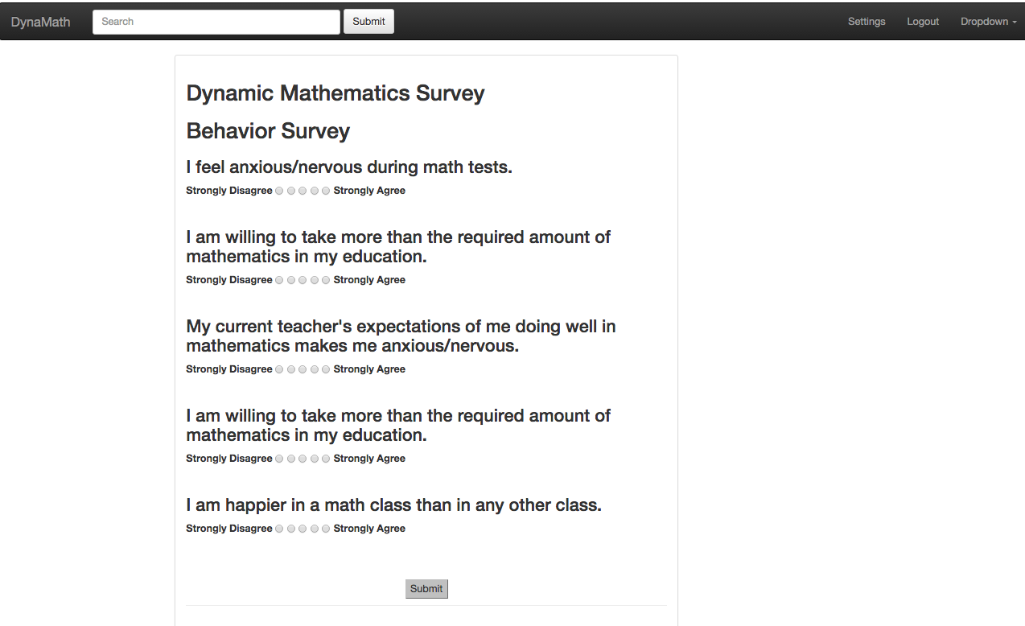
Step 12
The user is able to take a survey
User clicks on submit button to send data to the database

Slide 15
Step 13
The user clicks on logout button to exit application

